Slide 1



Chronic Diseases in Children/Adolescents on Antiretroviral Therapy
Preparing for What is to Come
Thanyawee Puthanakit, MD
¹Dept of Pediatrics, Faculty of Medicine, Chulalongkorn University
²HIVNAT, Thai Red Cross AIDS Research Center
Bangkok Thailand
Notes:
Title of this talk is on chronic diseases in children and adolescents on Antiretroviral therapy: Preparing for what is to come.
In 2018 2 million children and 5 million adolescent living with HIV worldwide – many of them received antiretroviral therapy for more than a decade.
With the current HIV diagnosis, treatment and care we expect near normal life expectancy.
Likewise, Bua, a perinatally HIV infected young lady in our clinic – she has a hope for bright future and name her painting as
“ growing positive with HIV”
So, let’s discuss how to prepare for what is to come for growing perinatally HIV infected youth.

Slide 2
Potential chronic diseases in adolescents on ART
Bone health
Mental health issues
Atherosclerosis Vascular Disease (AVD)
Prevalence
Screening
Prevention
Management
Cognitive Executive function
Notes:
HIV infection itself leads to chronic inflammation along PLUS long term use of antiretroviral drugs PLUS traditional risk factors
are predisposing HIV infected children and adolescents at risk of chronic diseases while growing into adulthood.
I would like to focus on 4 areas include
Atherosclerosis vascular risks suclinical adolescents – long term clinical moriblidty
Bone health which is a unique area for adolescent since it is a peak period of accrual
Mental health which is the
Cognitive and Executive function
In terms of
Prevalence, how to detect these conditions/ screening patients in the ARV clinic, and this effect the HIV treatment and overall health of the adolescents
how to appropriate service delivery to address this issue
Keep in mind is that the risk factors are in common, some patients have more than one risk factors
These NCDs are not speicaillcy to HIV positive indivuals and how we approach this as a general health protomotion in non-stigmatize way

Slide 3
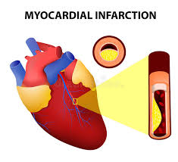
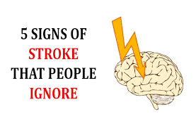
Atherosclerosis Vascular Diseases risks
2.2 times risk of AVD among HIV-infected individuals¹
Crude rate 62 per 10,000 person years
Accelerated atherosclerosis
Endothelial dysfunction
Increase arterial inflammation
Obesity*
Smoking
Dyslipidemia**
Hyperglycemia
Traditional risk factors³
Hypertension
Increase common carotid artery intimal thickness among HIV infected individuals
age 6-29 years²
¹Shah ASV. Circulation 2018.
2Hanna DB. Clin Infect Dis 2016:63:249-56.
3Partel K. Circulation. 2014;129:1204-1212.
Notes:
From the latest metanalysis of more then 800,000 people living with HIV (3.5 M PY),
it shows that people living with HIV has 2.2 times risk of atherosclerosis vascular diseases such as myocardial infarction or stroke
When compare to HIV negative control with and incidence of 62 per 10,000 PY.
The pathogenesis are from accelerated atherosclerosis from endothelial dysfuction and increase arterial inflammation from HIV
Data from > 1.500 HIV infected individuals showed increase common carotid artery intimal thickness especially age 6-29 years and also association with high blood pressure and low HDL.
Carotid arterial wall thickening is a subclinical atherosclearosis but thickening is one of pathogenesis others such as plague or thrombus formation has not been measured
(Data from US cohort show increase coronary artery wall thickness (1.3 + 0.2) vs (1.1+0.1) mm intimal thickness
Clin Infect Dis 2014:59:1779-86.)
PHACS study from US also assess AVDs using Pathobiological Determinants of Atherosclerosis in Youth (PDAY) coronary arteries
Show that 12% had >4 score increase risk of AVD
AND also from traditional risk factor such as dyslipidemia, insulin resistance, smoking and obesity,
** Dysplidemia: LDL > 130 and HDL < 40 mg/dl
In adolescents cohort, dyslipidemia in a range of 10% in Asia cohort 22% in PHACS cohort in the US
These 2 factors related to ARV: Smoking and obesity
*

Slide 4
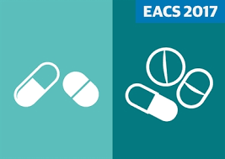


AVDs Risk Reduction
Antiretroviral drugs Early treatment
Substitute to safer drugs
No smoking
Pharmacotherapy: statins
P1063: Atorvastatin 10 mg among children 10-24 years if LDL > 130 mg/dl. 63% had LDL < 110 mg/dl or decline >30% at 4 weeks of treatment
Limited data in adolescents with HIV
especially on long term health impact
Boosted PI increase risk of dyslipidemia
Integrase inhibitors has less effect.
Exercise
Diet modification
Innes S. Curr opin HIV AIDS 2018;13:187-95
Melvin AJ. Pediatr Infect Dis J 2017; 36:53-60
Notes:
In principle:
Access to antiretroviral drugs help to reduce chronic inflammation and with new class of integrase inhibitors reduce risk of dyslipedmia
Behavioral modification: no smoking exercise and diet modification to prevent obesity
Concomitant treatment with statins of which there is limited data in adolescent with HIV.
Recently data from P1063 using atorvastatin if LDL > 160 mg/dl show that
40% reach target of lipid reduction within 3 months, yet need long term outcome.
The issue of drug-drug interaction, The statins are extensively metabolized by the CYP system
while in adult using new drug such as pitavastain which has better efficacy compare with pravastatin

Slide 5
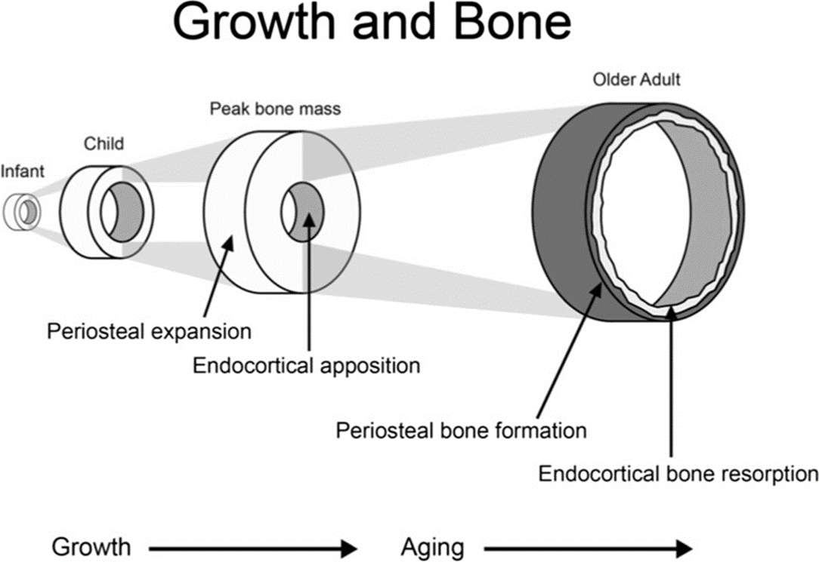
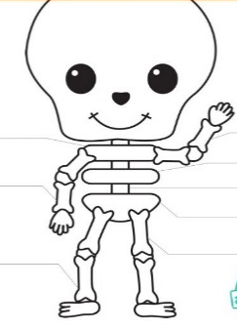
Bone Health: Optimizing bone mass
Physical activity (A)
Calcium (A)
Vitamin D (B)
DMPA injection (B)
HIV antiretroviral drugs
RDA: Calcium intake 1300 mg/day Vitamin D 600 IU/day
40% of bone mineral content acquired during puberty
@ age 13-14 years PLUS 4 years surrounding
Osteoporos Int 2016:27:1281-1386
Notes:
Bone Health: Time to optimizing peak bone mass is during adolescent year
During 4 years surrounding teenage 13-14 years: 40% of total BMC acquired and after this 95% of bone mass accrual**
Therefore, we would like to make it right during adolescent to reduce osteoporosis risk later in life.
Form the national osteoporosis foundation guideline. The factors that associated with bone health include physical activity,
Recommended Calcium intake 1300 mg/day Vitamin D 600 IU/day
Effect of Calcium/vitamin D = 0.5 to 5.8% gain at 1 year of supplement
Timing for peak bone mineral accretion rate @ 12.5(female) or 14(male) with 4 years surrounding that period 39% of total bone mineral acquired* after that 95% of bone mass achieved
DMPA = depot medroxyprogesterone acetate – effect on bone

Slide 6


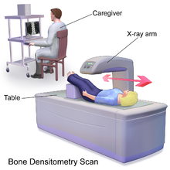
Bone health: HIV adolescents
¹Bone mineral density
BMD Z-score < -2 (osteopenia)
 | PHACS² | Thai³ | South Africa⁴
 | N=426 | N=166 | N=220
Age (years) | 16-24 | 14-18 | 5-9
Calcium intake(mg/d) | 713 | 257 | 99% inadequate
Low 25-OHD (<20 mg/dL) | 42% | 22% | N/A
*RDA: Calcium intake 1300 mg/day Vitamin D 600 IU/day
Dual Energy X-ray
Absorptiometry (DXA)
¹Sudjaritrak T, Puthanakit T. HIV med 2017.18:235-44.
²Jacobson D. JAIDS 2017:76:33-42.
³Sudjaritrak T. IAS 2017 abstract# MOAB02
⁴Shiau S. J Pediatr Gastroenterol Nut 2017;65:332-7.
Notes:
Tools for bone mass measurement is Dual Energy X-ray absorptiometry or DEXA scan, the simple one is lumbar spine which take less than 10 minutes to do a test
This graph on
SA data vitamin D < 10 ug/day and Calcoum < 800 mg/d

Slide 7

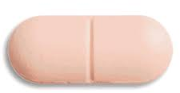
Calcium and vitamin D supplement
 | ATN109 (N= 214 ) | Thai (N=24) | Thai CAL-D (n=67)
Age (years) | 22 (16-24) | 14 (13-15) | 16 (14-18)
Baseline characteristics | TDF cART (62% low 25-OHD) | Mean BMD Z-score -2.6 | BMD Z-score <-2
Supplement calcium/vitamin D | Calcium 162 mg Vit D 400 IU) + D3 50,000 IU/mo. for 1 year | Calcium 1200 mg/ Vit D2 400 IU daily for 6 months | Calcium 1200 mg/ Vit D2 400 IU for 1 year + D2 20,000 IU weekly (high dose)
Bone mineral density outcome | Increase BMD +1.1% | BMD Z-score increased from -2.6 to -1.7 | BMD Z-score +0.49 (normal dose) +0.74 (high dose)
¹Haven P. ATN 109.Clin Infect Dis 2018:66:220-8
²Puthanakit T. J Virus Erad 2018:4:6-11.
³Sudjaritrak T. IAS 2017 abstract# MOAB02
Notes:
Example of study to give supplement calcium and vitamin D among adolescent with vitamin D deficiency or low bone mineral density.
Basically with supplement it shows significanlty improved in Bone mineral density.
Importantly to note that it is the thershold effect of calcium and vitamin D - supplement is worked will in population which show inadequate intake **

Slide 8
Challenge in Bone Health in LMICs
Limit access to bone densitometry scan
Majority of adolescents had inadequate intake of calcium and vitamin D
Improvement of BMD after supplement of calcium/vitamin D among adolescents with low baseline BMD
Dual Energy X-ray
Absorptiometry (DXA)
Research gaps
What are the long term effect on bone health
if give routine supplement of calcium/vitamin D during teenage years?

Slide 9
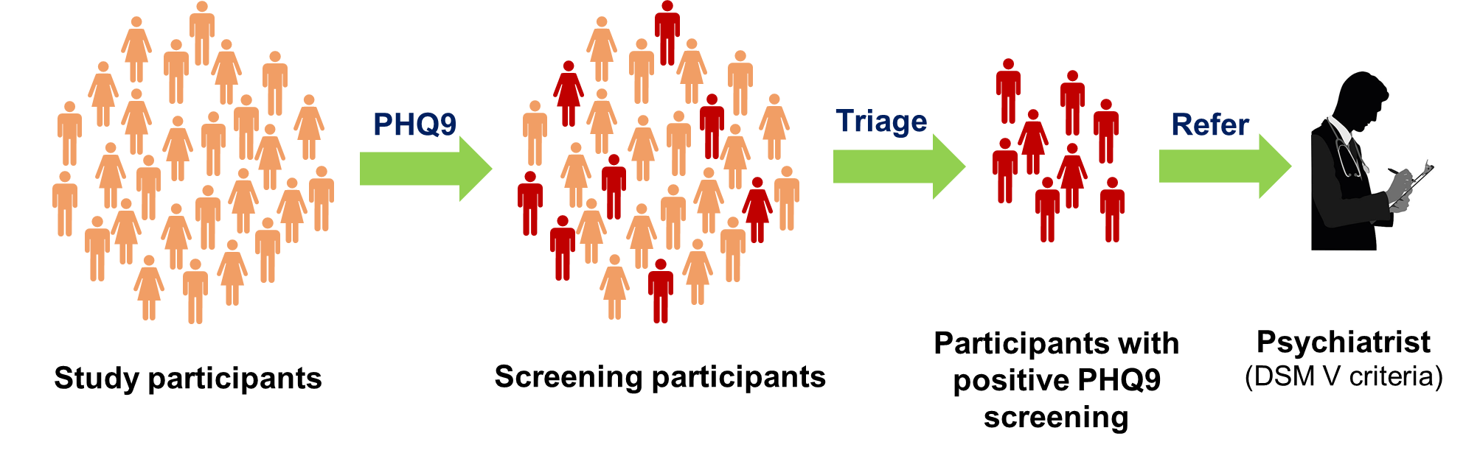
Mental health among adolescents
Psychosocial assessments: HEEADSSS
Home, Education/Employment, Eating,
Activities, Drugs, Sex, Suicidal, Safety
Simple mental health screening tests
  Children Depression Inventory (CDI)
  Patient Health Questionnaire-9 (PHQ-9)
  Center for Epidemioological study depression scale (CES-D)
Integrated mental health in HIV care
Screening- Diagnosis – Intervention
Depressive symptoms
Poor appetite
Sleep disturbance
Fatigue
Psychomotor retardation
Suicidal ideation
Suicidal attempt
Notes:
* Edinburg Post Natal depression scale: application can be widely used

Slide 10



Mental health among adolescents
 | Resilience¹ | Mental health² | USA³ | Malawi⁴
Age (years) | > 10 years N=223 | 15-25 years N=150 | 9-16 years N =206 | 12-18 years N =562
Assessment | Screening tools CDI CES-D | PHQ-9 & evaluation by psychiatrist | Diagnostic Interview Schedule for Children | Beck Depression Children scale
Prevalence | Depression 12%-27% (age < 15 years vs > 15 years) | 10% had depression, adjustment disorders 9% suicidal ideation | 7% mood disorder | 19%depression 7% suicidal ideation
¹Songtaweesin N. 10th International workshop HIV Pediatrics 2018 ²Sudjaritrak T. 10th International workshop HIV pediatrics 2018
³Mellins CA. J Child Psychol Psychiatry 2009;50:1131-8; ⁴Kim MH. J Int AIDS Soc 2014;17:18965
Notes:
Prevalence
US: PHACS, ATN, CASAH
Asia: TREATAsia, Resilience cohort
Africa: ?
In metanalayis among adult 24% had PHQ9 > 9 = 24% and Prevalence of MDD = 14%
Patel P. AIDS 2018;32: suppl1: S5-20

Slide 11
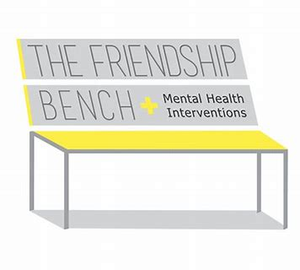
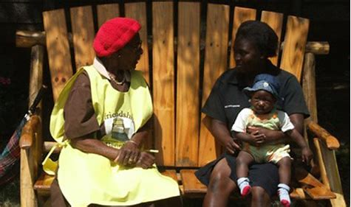
Mental Health support: Zimbabwe
Task shifting of mental health to lay healthcare workers (grandmothers)
Randomized trial of mental health intervention by “Friendship bench”
6 sessions of “problem-solving therapy”
and peer support group
573 participants during 2014-2015 Median age 33 years, 42% HIV+ve
Significantly less depressive symptoms 14% vs. 50% at 6 months
Kugfungisisa
Interventions for depression
Medication (SSRIs, tricyclic agents)
Interpersonal psychotherapy
Cognitive behavioral therapy
Chibanda D. JAMA 2016;316:2618-26.
Patel P. AIDS 2018;32:Suppl 1:S5-20.
Notes:
Using SSQ-14= Shona Symptom Questionaires
(scale 0 to 14) 9 is a cut off

Slide 12
Cognitive and Executive functions
Prevalence of impaired cognitive functions
Adolescent is a period of which limbic regions (emotions) function develop ahead of prefrontal regions (logic).
Cognitive & Executive functions may be impaired due to psychosocial factors and chronic HIV infection
Executive function
Children’s Color Trails Test-2 (CCTT-2)
Design Fluency Test (DFT)
Working memory: Freedom of distractibility index
Processing speed index (PSI)
Kerr S. # THPEB146

Slide 13
Research gaps in NCDs in LMICs
What are appropriate NCD diagnostics test and medications should be available in LMICs?
Should “Triage” decisions be made based on risk stratification?
What impact will NCD integration have on HIV workflows and quality?
What training modules should be used to build HCWs and community capacity to handle NCDs?
Susan V. AIDS 2018;32:S107-113.

Slide 14
How to prepare HIV & NCDs Integrated care
Access to metabolic friendly ARV regimens
Health promotion using community approach: Smoking
Simple tools for NCDs screening: Hypertension, Obesity
Mental health screening and task shifting
Supply chain for non-ARVs non-OI medications
Notes:
Education and counselling for broader health promotion and life style
Prepare family for the right attitude of child rearing and preparing adolescent to real life

Slide 15
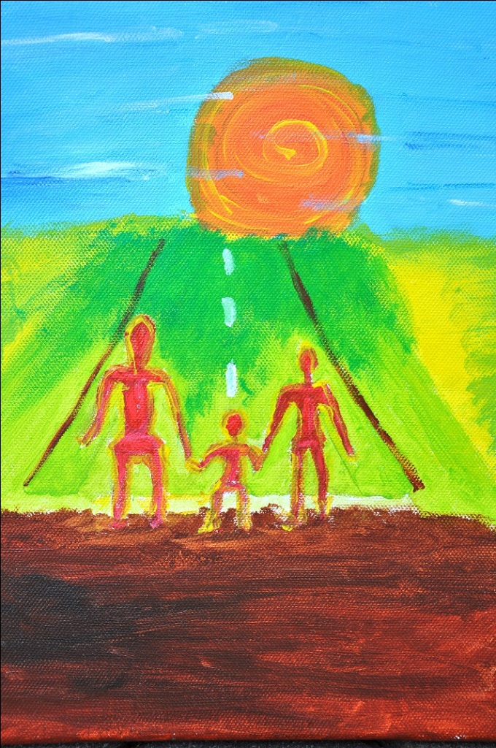
CONCLUSIONS
HIV comorbidities are manifesting in decades to come
Minimize HIV associated risks by early ART
& safer ARVs during maintenance period
Maintain adequate nutrients & physical activities
Modify traditional risk factors e.g smoking
Mental Health is integral part for adolescent care
My life
“ For my future, I would like to have family, house, rice farm and money which I earn for a living.”
“I am on the promising way of hope.”
Notes:
With effective antiretroviral therapy Opportunitistic infections decline but the HIV comorbidities are increasing
HIV comorbidities are manifesting in 2nd and 3rd decade of life..
I am optimistic that the HIV co-morbidities or non communicable diseases complications are manageable by
Early treatment with antiretroviral therapy to reduce chronic inflammation related to chronic HIV infection and safer antiretroviral drugs during maintenance phase
Modify traditional risk factors to Atherosclerosis Vascular diseases e.g. smoking, obesity, dyslipedmia
Maintain adequate nutrients especially for bone health during time of bone mass accrual
Mental health is integral part of adolescent care to support them to go thorough period of vulnerability
I would like to end my talk that in the past 2 decades we have come so far avert death in pediatric HIV
--- I do believe that we will be able to do more and better to ensure that this young man dream will come true
“ For my future, I would like to have family, house, rice farm and money which I earn for a living.
I am on the promising way of hope.

Slide 16
Acknowledgements
Research teams
  Resilience study (5R01MH102151)
  Mental health (TREAT Asia)
  CAL-D team (TREAT Asia)
Colleagues for sharing thoughts and ideas
  Steve Innes
  Stephen Arpadi
  Tavitiya Sudjaritrak
  Chutima Saisangcheon
  Mutsa Bwaka Dangaremibizi
Special thanks to children and families
# Growing positive with HIV

